Slide 1

Technical Environment Systems 2019-2020 |
Professor: Behzad Najafi
Students: Nikolic Andela | Kovinic Ira | Mekic Emir | Ceneric Filip
SIMULATION OF BUILDING PERFORMANCE

Slide 2
| content
1 Locations
2 Specifications of the building
3 Process
4 Walls
5 Comparison of annual energy consumption
6 Conclusion

Slide 3


| locations
Moscow
Podgorica
Abu Dhabi
City | Podgorica | Moscow | Abu Dhabi
Longitude | 19.26 | 37.61 | 54.36
Latitude | 42.44 | 55.75 | 24.46
Elevation | 48 m | 156 m | 27 m

Slide 4
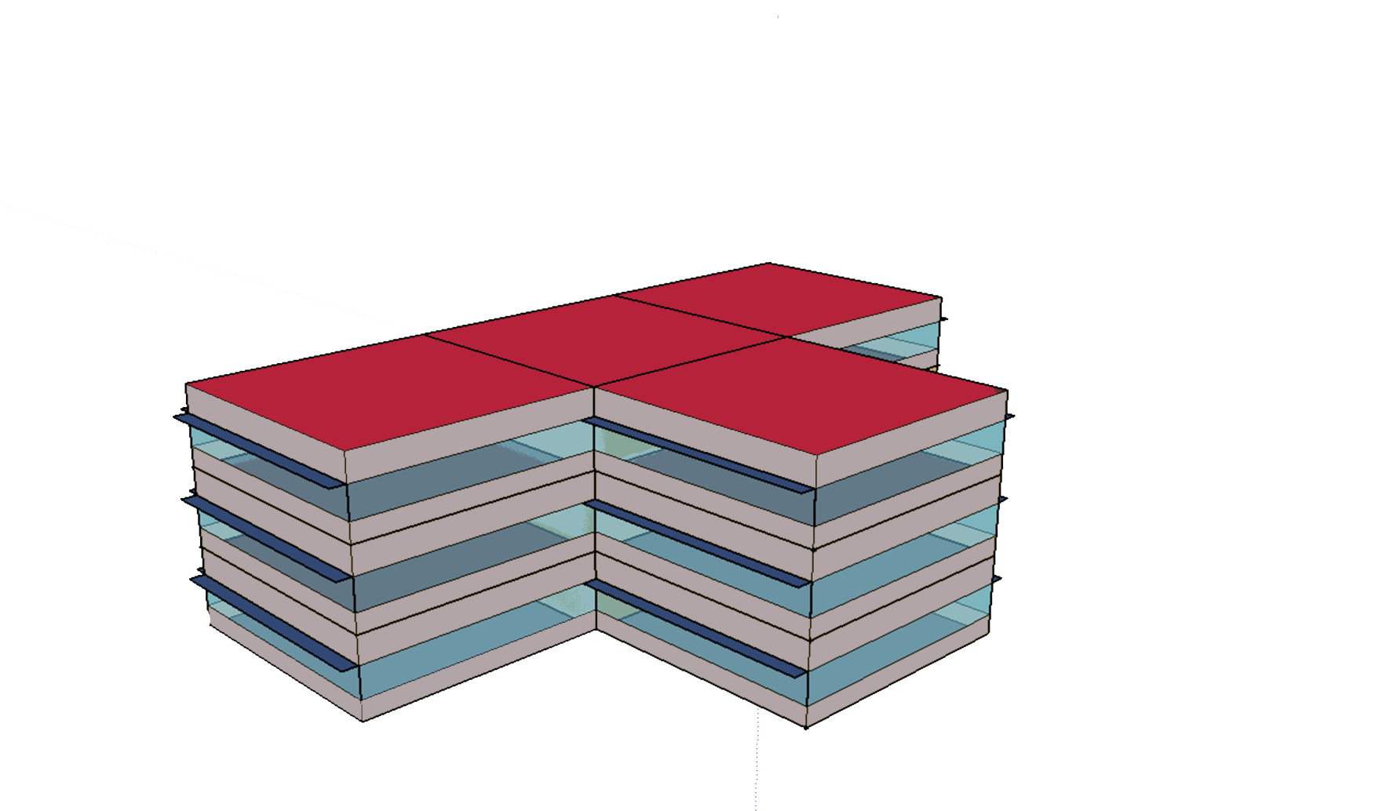
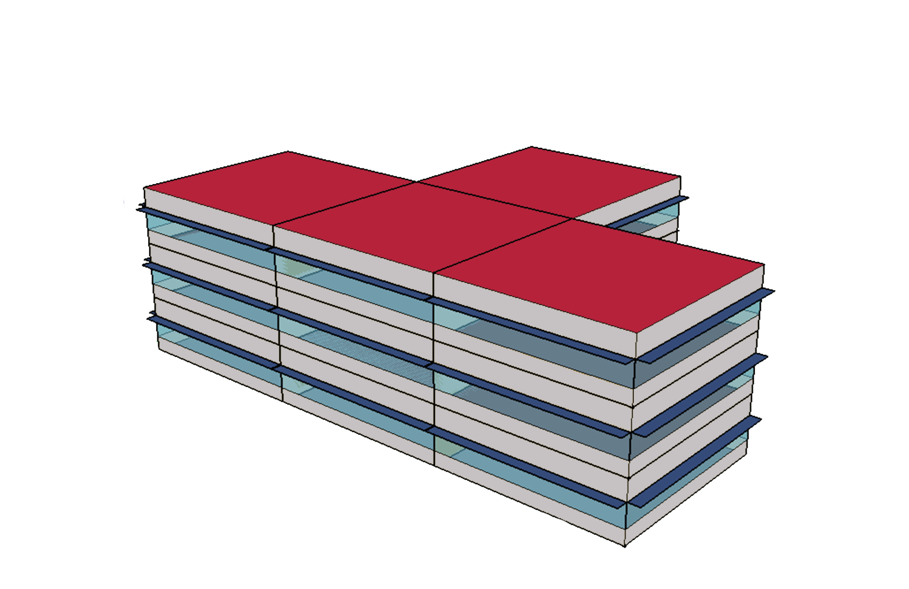
| specifications of the building

Slide 5


| process

Slide 6



| walls
WALL 2
BASE WALL 1
WALL 3
MATERIAL
R value
MATERIAL
MATERIAL
R value
R value
OUTSIDE
[m2 C/W]
OUTSIDE
[m2 C/W]
[m2 C/W]
OUTSIDE
1IN Stucco
25mm
8IN Concrete HW 200mm
1/2IN Gypsum 13mm
0,037
1,17
0,079
1IN Stucco
25mm
8IN Concrete HW 200mm
Insulation
10cm (glass fiber)
1/2IN Gypsum 13mm
0,037
1,17
2,8
0,079
1IN Stucco
25mm
8IN Concrete HW 200mm
Insulation
25mm (mineral fiber)
1/2IN Gypsum 13mm
0,037
1,17
0,66
0,079
INSIDE
R total
INSIDE
INSIDE
R total
R total
1.286
1.086
1.946
U2 = $\frac{1}{R}$
U value
U1 = $\frac{1}{R}$
U value
U3 = $\frac{1}{R}$
U value
0,7776
0,2447
0,5138

Slide 7
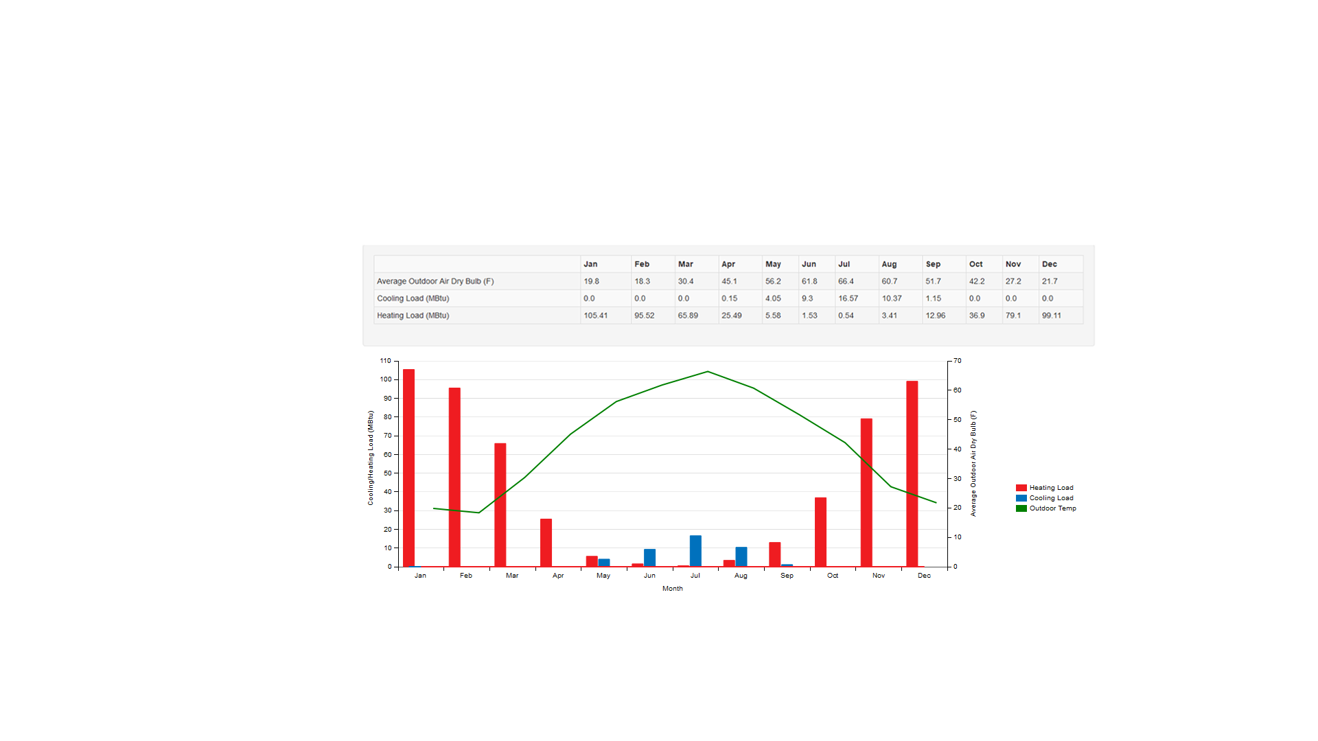


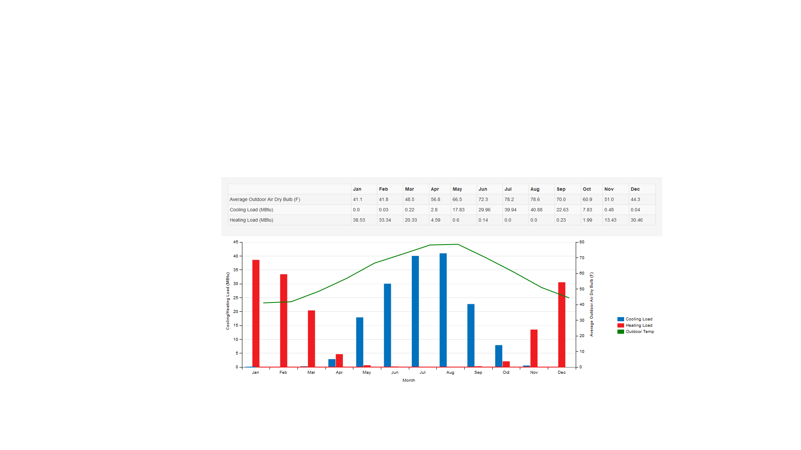

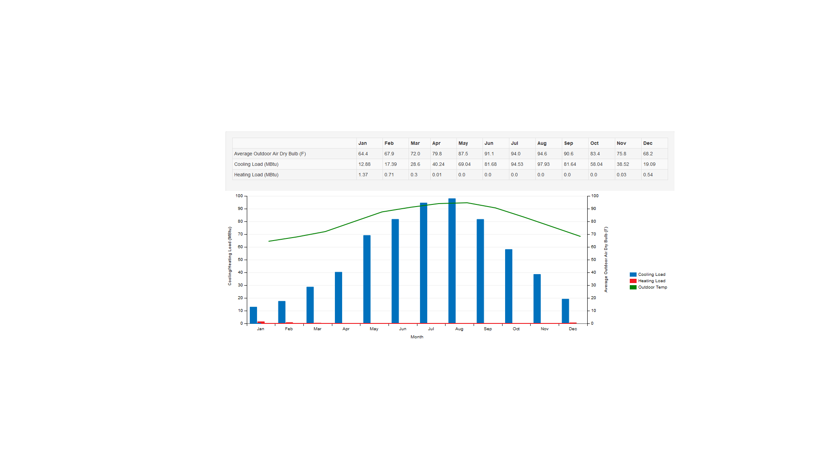
Moscow
THREE CITIES ANALYSIS ( BASE WALL )
5%
16%
Heating
Total consumption
Annual heating 531,422 kBtu
Annual cooling 41,581 kBtu
Interior Equipment
Interior Lightening
Cooling
17%
62%
Podgorica
24%
27%
Cooling
Interior Equipment
Total consumption
Annual heating 143,642 kBtu
Annual cooling 162,626 kBtu
Heating
Interior Lightening
24%
25%
0%
Abu Dhabi
15%
Cooling
Interior Equipment
16%
Interior Lightening
Total consumption
Annual heating 2,967 kBtu
Annual cooling 639,596 kBtu
Heating
69%

Slide 8
Comparing results with base wall
Three cities total district cooling and heating
Units [ mBtu ]
Comparing different walls in PODGORICA
Units [ mBtu ]

Slide 9
| conclusion
Moscow is the location that is consuming the highest amount of energy on heating because of its cold climate and requires the thickest insulation of the wall that reduce the heating costs.
Podgorica is consuming almost the same amount of energy of heating and cooling depending on part of the year since this is caused by moderate climate. Insulation layer can be thinner since the increasing the thickness will not change energy consumption value significantly.
The highest amount of energy is consumed on cooling in Abu Dhabi. That being said the wall insulation is required so it can reduce the outside effects of heat and reduce yearly cooling costs.

